Slide 1
Isaiah 1:14-20 (NIV)
14Your New Moon festivals and your appointed feasts my soul hates. They have become a burden to me; I am weary of bearing them. 15When you spread out your hands in prayer, I will hide my eyes from you; even if you offer many prayers, I will not listen. Your hands are full of blood; 16wash and make yourselves clean. Take your evil deeds out of my sight! Stop doing wrong, 17learn to do right! Seek justice, encourage the oppressed. Defend the cause of the fatherless, plead the case of the widow.

Slide 2
Isaiah 1:14-20 (NIV)
18"Come now, let us reason together," says the Lord . "Though your sins are like scarlet, they shall be as white as snow; though they are red as crimson, they shall be like wool. 19If you are willing and obedient, you will eat the best from the land; 20but if you resist and rebel, you will be devoured by the sword." For the mouth of the Lord has spoken.

Slide 3
Looking Back – Living Forward
Lessons for today, learned from Old Testament Prophets

Slide 4
Looking Back – Living Forward
Lessons for today, learned from Old Testament Prophets
April 24th – Philip Adams
Isaiah

Slide 5
Looking Back – Living Forward
Isaiah
12 Minor Prophets and 4 Major prophets (5 books) –
Isaiah, Jeremiah, Ezekiel and Daniel
Major prophets distinguished by having more to say.
Isaiah had a lot to say!

Slide 6
The Major Prophets
Isaiah
The five books of The Major Prophets (Isaiah, Jeremiah, Lamentations, Ezekiel, and Daniel) cover a significant time span and present a wide array of messages.
Isaiah spoke to the nation of Judah about 150 years before their exile into Babylonia and called them to be faithful to God.
Jeremiah cried out to the same people on the brink of exile and pleaded for repentance.
Lamentations, written by Jeremiah, presents a dirge as Judah went into exile.
Ezekiel and Daniel, spoke and wrote to the people in exile, encouraging them to remember that God was still in control.

Slide 7
Why Study the Major Prophets?
Isaiah
(1) They’re part of God’s Word
¹⁶ All Scripture is God-breathed and is useful for teaching, rebuking, correcting and training in righteousness, (2 Timothy 3:16)

Slide 8
Why Study the Major Prophets?
Isaiah
(2) Key part of old testament prophecy
Bible prophecy or biblical prophecy comprises the passages of the Bible that are claimed to reflect communications from God to humans through prophets. Jews and Christians usually consider the biblical prophets to have received revelations from God.
The old testament prophets were not all about the future. Most of what they said were to the people in front of them – forthtelling (telling people like it is).
Only a small amount was foretelling (about the future).
About 5% concerns the coming of Jesus.
About 2% about the new age of the church and about 1% is yet to be fulfilled.

Slide 9
Why Study the Major Prophets?
Isaiah
(3) They link the Old Testament with the New Testament (Jesus and Paul quote Isaiah extensively)

Slide 10
Why Study the Major Prophets?
Isaiah
(4) They reveal Jesus
Isaiah sounds more like a New Testament writer than an Old Testament prophet.
A central Messianic passage in Isaiah is 52:13 – 53:12, revealing:
(52:13-15) Jesus’ wholehearted sacrifice (burnt offering).
(53:1-3) Jesus’ perfect character (meal offering).
(53:4-6) Jesus brought atonement that issues in peace with God (peace offering).
(53:7-9) Jesus paid for the transgression of the people (sin offering).
(53:10-12) Jesus died for the effects of sin (trespass offering).

Slide 11
Why Study the Major Prophets?
Isaiah
For to us a child is born, to us a son is given,
and the government will be on his shoulders.
And he will be called Wonderful Counsellor, Mighty God,
Everlasting Father, Prince of Peace.
7 Of the greatness of his government and peace
there will be no end.
He will reign on David’s throne and over his kingdom,
establishing and upholding it with justice and righteousness
from that time on and forever.
The zeal of the Lord Almighty will accomplish this. (Isaiah 9:6-7)

Slide 12
Why Study the Major Prophets?
Isaiah
(5) They give us a bigger view of God
Not a Old Testament God
Not a New Testament God
But the God who transcends everything who is keenly interested in us as individuals and part of societies.

Slide 13
Isaiah himself
Isaiah
The man himself plays a secondary role in the book.
He is referred to as “the prophet”.
He is commissioned in Chapter 6.
8 Then I heard the voice of the Lord saying, “Whom shall I send? And who will go for us?”
And I said, “Here am I. Send me!”
9 He said, “Go and tell this people: “‘Be ever hearing, but never understanding; be ever seeing, but never perceiving.’

Slide 14
Isaiah himself
Isaiah
Traditional view is that he wrote the book between 740 BC and 686 BC, with a gap in between. Covers five different Kings.
Another view is that he wrote the first part (chapters 1-39) and the remainder was written 200 years after his death (before and after the exile in Babylon)

Slide 15
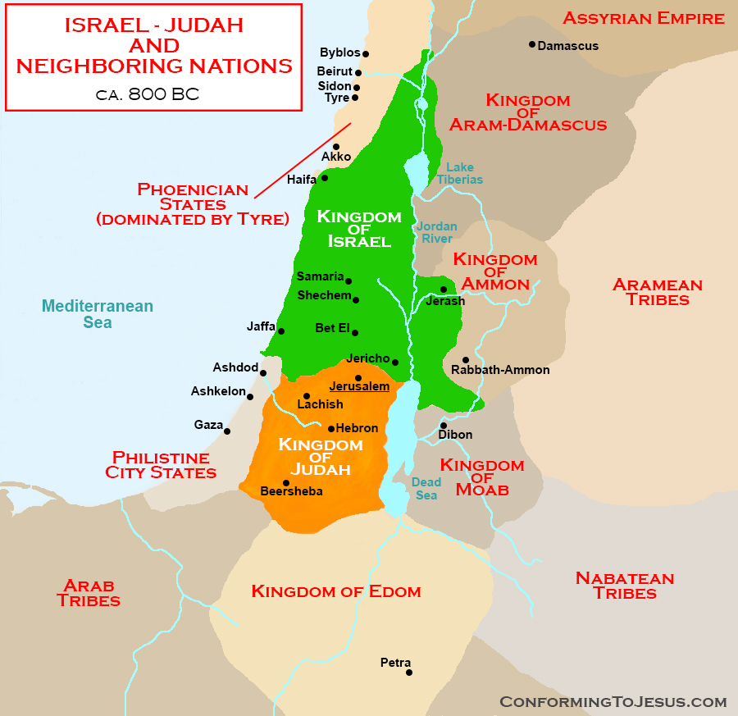
Who is he speaking too?
Isaiah

Slide 16
Like a miniature Bible.
Isaiah
The first thirty-nine chapters (like the thirty-nine books of the Old Testament) is about CONFRONTATION - judgment upon immoral and idolatrous men. Judah has sinned; the surrounding nations have sinned; the whole Earth has sinned. Judgment must come, for God cannot allow sin to go unpunished forever.
Final twenty-seven chapters (like the twenty-seven books of the New Testament) is about hope and COMFORT. The Messiah is coming as a Saviour and a Sovereign to bear a cross and to wear a crown.

Slide 17
https://www.youtube.com/watch?v=d0A6Uchb1F8

Slide 18
Today – Confrontation (chapters 1-39)
Isaiah
If you don’t face your past – you cant free your future.
If you don’t get your act together – tidy up your life,
then the Assyrians (and later the Babylonians) will tidy it up for you.

Slide 19
Lesson 1(chapters 1-10)
Isaiah
God confronts dead religion but loves passionate devotion (Isaiah 1:13-17)
Stop bringing meaningless offerings! Your incense is detestable to me. New Moons, Sabbaths and convocations— I cannot bear your worthless assemblies.
.
Wash and make yourselves clean. Take your evil deeds out of my sight; stop doing wrong. ¹⁷ Learn to do right; seek justice. Defend the oppressed. Take up the cause of the fatherless; plead the case of the widow.

Slide 20
God confronts dead religion but loves passionate devotion
Isaiah
Signs of a dead religious life
We trifle with God (only on Sundays)
We flirt with Idols
We toy with social justice

Slide 21
God confronts dead religion but loves passionate devotion
Isaiah
How to restore passionate devotion (Isaiah 6:1-8)
Get a fresh vision of God (verse 1)
Restore your conscience (5)
Transform your conversation (7)
Let God shape your will (8).

Slide 22
God confronts dead religion but loves passionate devotion
Isaiah
Q1 As Jesus entered Jerusalem in the week leading up to the crucifixion what did he first do?
Q2 Has my Christian faith become a flirtation?

Slide 23
Lesson 2 (chapters 13-23)
Isaiah
God loves HIS world but he confronts nations
and he is deeply involved
A series of judgements against many states and nations who had forgotten who had created them:
Babylon (13:1-14:23), Assyria (14:24-27), Philistines (14:28-32)
Moab (15-16), Syria and Israel (17), Ethiopia (18)
Egypt (19), Egypt and Cush (20), Babylon (21:1-10)
Edom (21:11-12), Arabia (21:13-17), Jerusalem (22), Tyre (23)

Slide 24
God loves HIS world but he confronts nations and he is deeply involved
Isaiah
God is not interested in riches and grandeur.
God is not interested in Politics
God is not interested in Passports
God is not interested in armchair (uninvolved) theologians

Slide 25
God loves HIS world but he confronts nations and he is deeply involved
Isaiah
Q1 What does God think when the Lord’s prayer is observed each day at the opening of parliament?
Q2 It seems that some Christian lobby groups have far more to say on gay marriage, sex education, LGBT rights, etc., than on aged care, support for the poor, asylum seekers, etc. Have they got the balance right?

Slide 26
Lesson 3 (chapters 24-34)
Isaiah
God confronts rebellion but promises redemption.
To the obstinate nation He Confronts – Isaiah 30:12-14
Despite it all, He Promises Redemption – Isaiah 30:15-18

Slide 27
Lesson 3 (chapters 24-34)
Isaiah
God confronts rebellion but promises redemption.
Q1 Is it possible to have Redemption without Confrontation?
Q2 Where have you seen redemption in your life? Reflect on a time when you were in need of God’s redemption and found it. How did it happen?

Slide 28
Lesson 4 (chapters 36-39)
Isaiah
Don’t lock the front door and leave the back door open or God can do the BIG things if we deal with the small things – the story of Hezekiah
A narrative about Hezekiah, a good King
God saves Jerusalem from the Assyrians and peace comes.
Hezekiah falls ill
God intervenes and grants him another 15 years to live.
King of Babylon hears about the illness and sends envoys with gifts.

Slide 29
Lesson 4 (chapters 36-39)
Isaiah
Don’t lock the front door and leave the back door open or God can do the BIG things if we deal with the small things – the story of Hezekiah
But pride enters and Hezekiah fails.
He shows the Babylonians everything.
They weren't Hezekiah’s treasures, but God’s gifts.
Jesus dies for our sins, giving us everything we need.
But its up to us to keep our lives in order.

